Slide 1
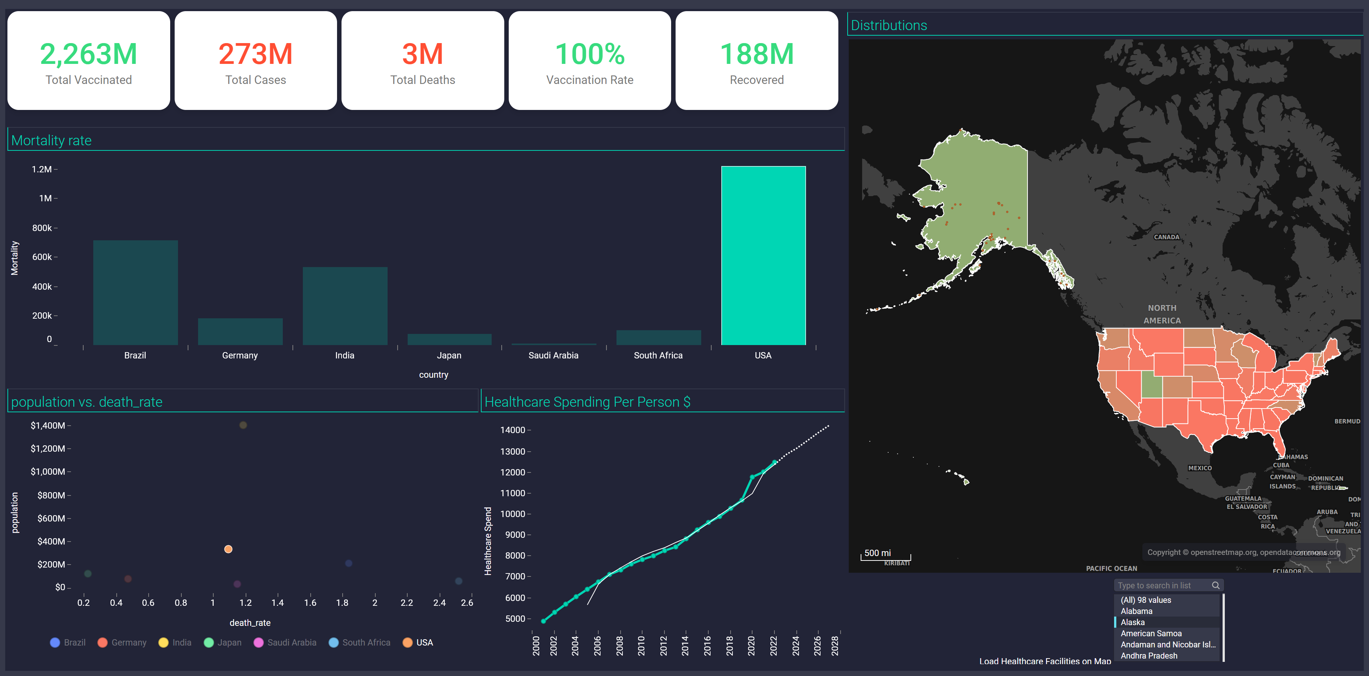
Covid Mortality and Healthcare
Filter Settings
Statewise Covid19
- state: (Alaska)

Slide 2
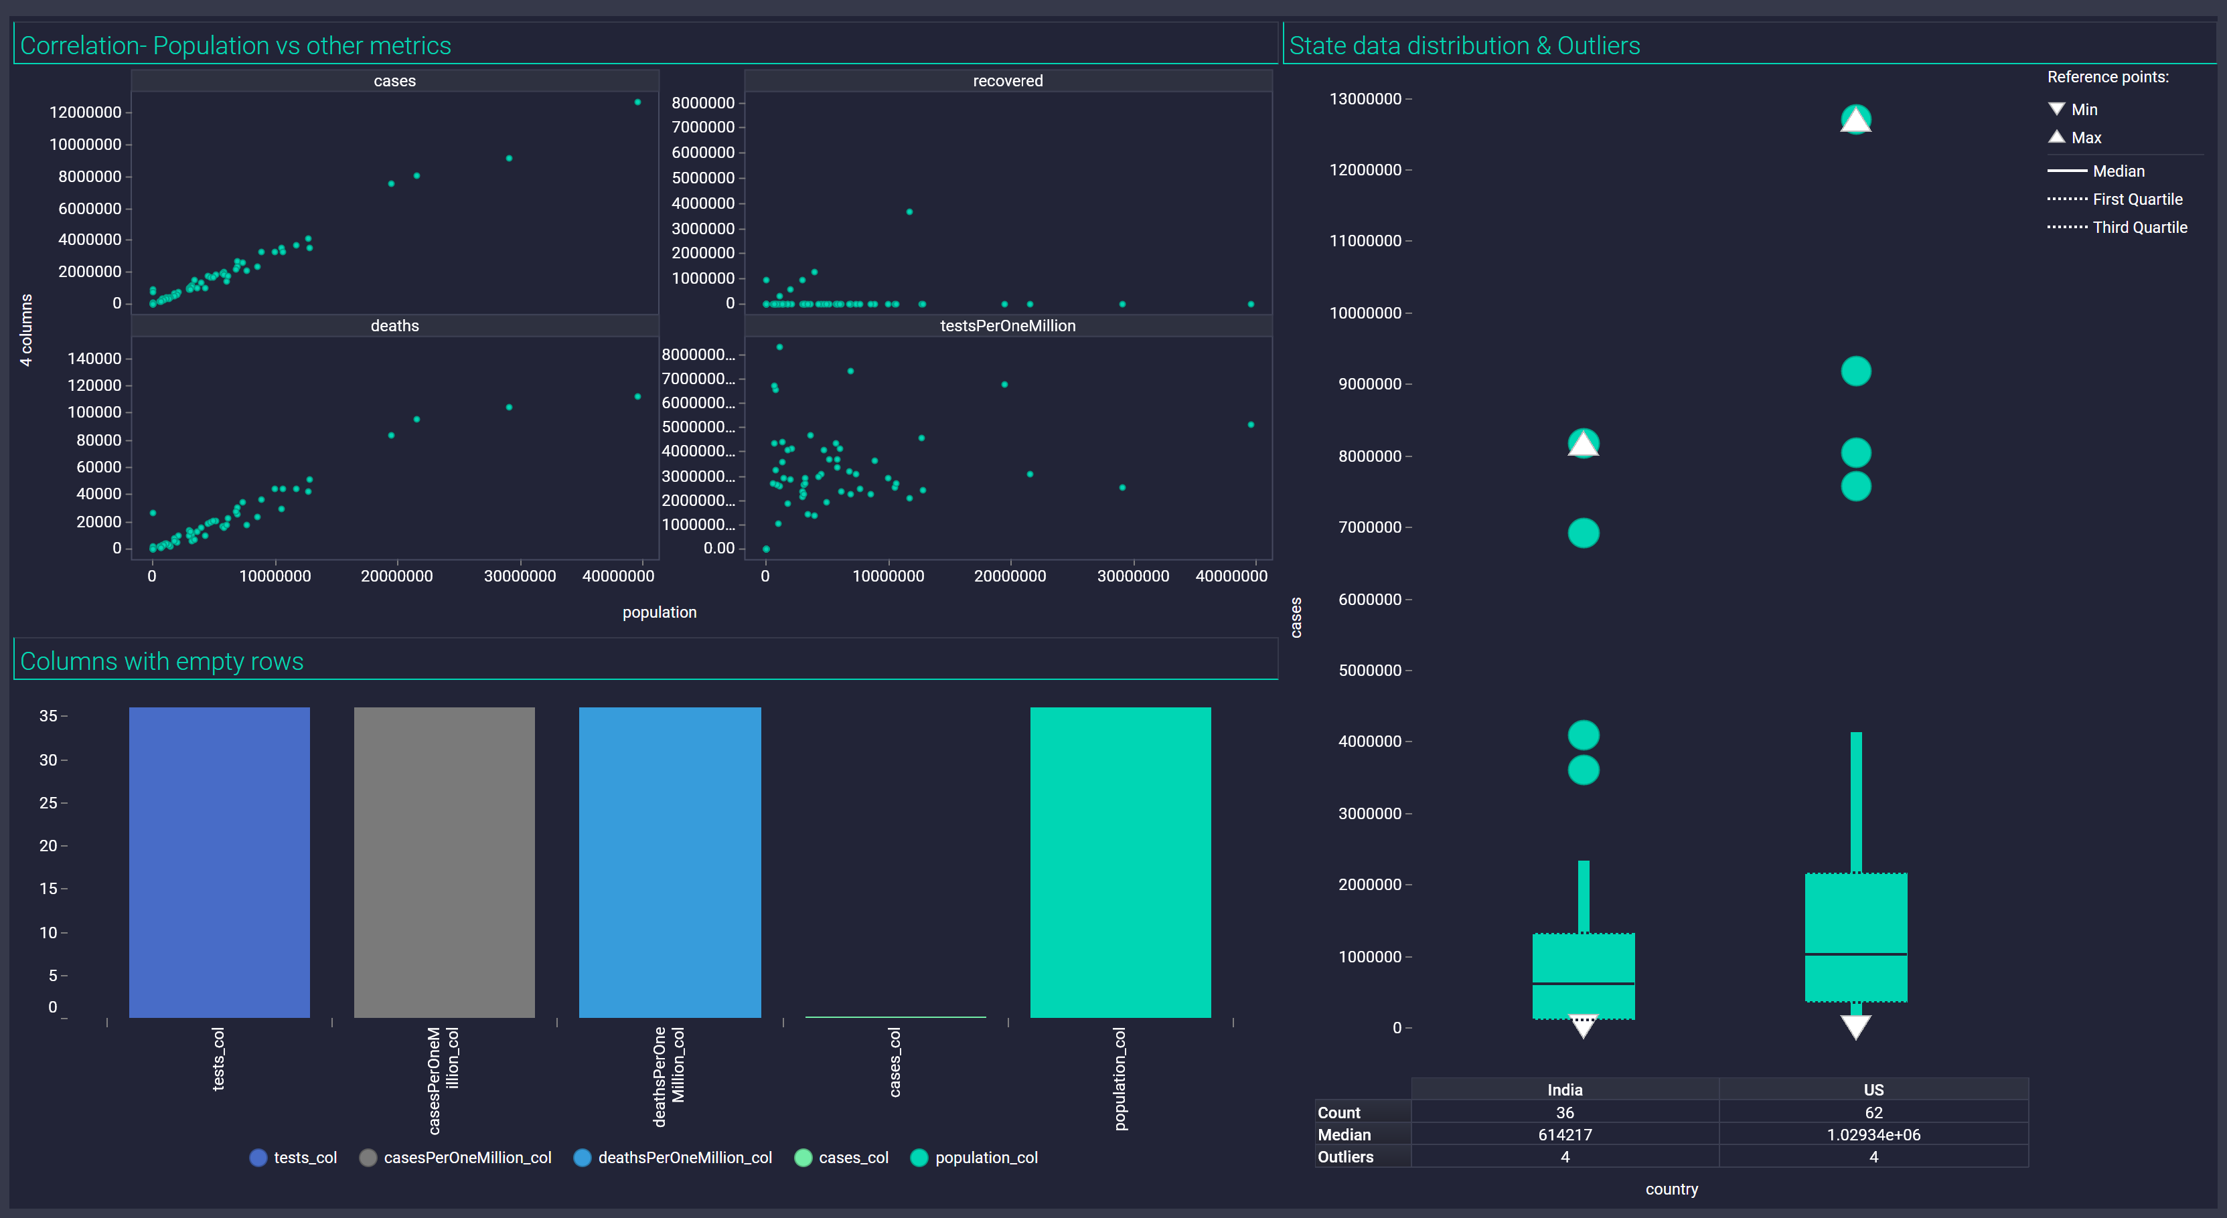
EDA

